Slide 1
IBM University Engagement
Project Submission
“Exploring the Power of Agentic AI with IBM Granite and LangFlow”

Slide 2

Project Title – FinGuide-AI Domain of Project - Financial Literacy / FinTech
Student Name | Recent Passport Photo | Email ID | Mobile number [WhatsApp]
Vardhineedi Tharaka Venkata Gopal |  | vtharak88@gmail.com | +91 86885 66686

Slide 3
Problem Statement - FinGuide-AI
The Challenge
Digital financial tools are essential today, but many users struggle to navigate UPI, understand interest rates, manage budgets, and avoid online financial scams. Reliable information is scattered across government portals, banking websites, and educational platforms. Without personalized, real-time, and multilingual guidance, users from diverse backgrounds often fall victim to fraud or fail to make informed financial decisions.
Objective
Build an AI-powered Digital Financial Literacy Agent powered by RAG (Retrieval-Augmented Generation) that:
Retrieves reliable content on UPI usage, scam avoidance, interest rates, budgeting, and personal finance.
Fetches data securely from government portals, banking websites, and educational platforms.
Offers multilingual support so users can interact in their preferred language.
Empowers users with personalized knowledge, protects them from fraud, and builds confidence in digital finance.

Slide 4
Proposed Solution - AI-Powered Financial Literacy Agent
The proposed solution is an AI-powered Financial Literacy Agent built using LangFlow, IBM Cloud, and IBM Granite models to provide accessible, personalized, and culturally inclusive financial education.
At its core, the solution uses a Retrieval-Augmented Generation (RAG) pipeline to fetch accurate financial data from trusted sources like government portals and banks. This data is embedded and stored in a vector database, enabling the system to retrieve and summarize safe financial practices using Granite models.
The system features specialized agents:
Financial Knowledge Agent: Retrieves accurate data on UPI, loans, and budgeting using RAG.
Scam Prevention Agent: Identifies potential fraud patterns and educates users on safe digital transactions.
Multilingual Advisory Agent: Translates and localizes financial concepts into the user's preferred language for inclusive interaction.
Personal Finance Agent: Guides users on budgeting, interest rates, and personal finance management.
The solution includes a user-friendly web interface (deployed on Vercel) that allows users to ask questions like “How do I send money via UPI?” or “What is a safe interest rate for a loan?” LangFlow orchestrates agent workflows, while IBM Cloud ensures scalable and secure deployment.

Slide 5
Technology Used
Langflow Platform: For designing and orchestrating multi-agent workflows visually.
IBM Granite Model: (e.g., ibm-granite-3-2-8b) – For natural language understanding, reasoning, and multilingual personalization.
IBM Cloud: Provides the infrastructure to build, deploy, and scale the FinGuide-AI agent efficiently in a secure environment.
RAG (Retrieval-Augmented Generation): Fetches real, verified financial data first, then generates intelligent answers, making the agent trustworthy and fraud-resistant.
Vector Database (FAISS/Chroma): For RAG-based financial data retrieval from government and banking sources.
Frontend/Deployment: React/Vercel (Deployed Link: https://fin-guide-ai-six.vercel.app/)

Slide 6
Langflow Component Used
Chat Input: Interface where users enter their financial queries (e.g., "How to avoid UPI scams?") via text.
IBM watsonx AI Agent: Processes user input using Granite models to generate personalized financial insights.
Name of IBM Granite model: Granite-4.0-8B-Instruct (or equivalent) → Fast, efficient for real-time multilingual financial recommendations.
Chat Output: Displays AI-generated responses such as step-by-step UPI guides, budget plans, and scam alerts.
File/URL Component: Fetches and stores reliable financial documents from government portals and banking websites for RAG.
Vector Store Retriever: Connects to the vector database to fetch relevant financial context.

Slide 7
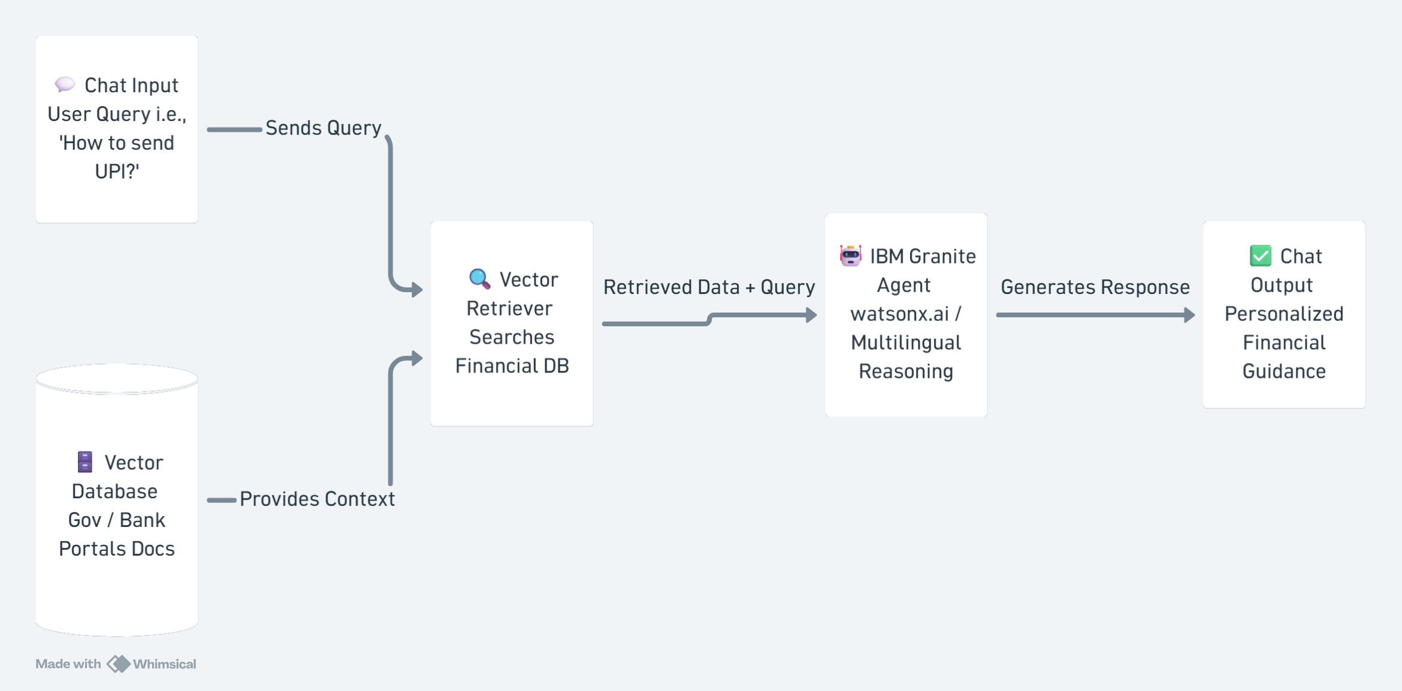
Langflow Workflow

Slide 8
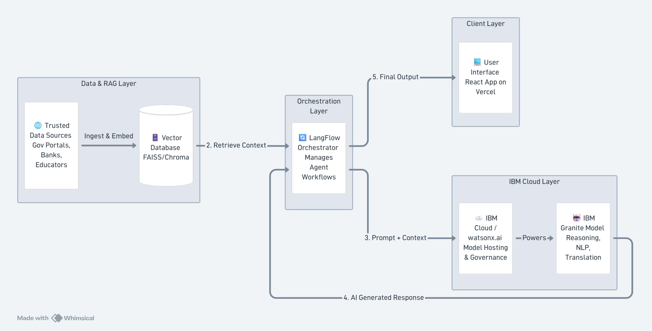
Architecture Blueprint

Slide 9
Role of Agentic AI in the solution
Agentic AI enables FinGuide-AI to function as an intelligent, autonomous financial advisor rather than a simple chatbot. Using IBM Cloud and IBM Granite models, it coordinates multiple specialized agents to deliver personalized financial guidance.
Each agent performs a specific role—such as retrieving verified banking data, generating budget plans, providing scam alerts, and translating responses—while working collaboratively. This multi-agent approach ensures efficient task execution and accurate results.
Agentic AI also brings context awareness, understanding user backgrounds and preferred languages to generate tailored recommendations. It supports real-time adaptation, updating suggestions based on the user's specific financial queries.
Overall, Agentic AI makes the system proactive, personalized, and goal-driven, acting like a smart digital financial advisor that protects users from fraud and builds financial confidence.

Slide 10
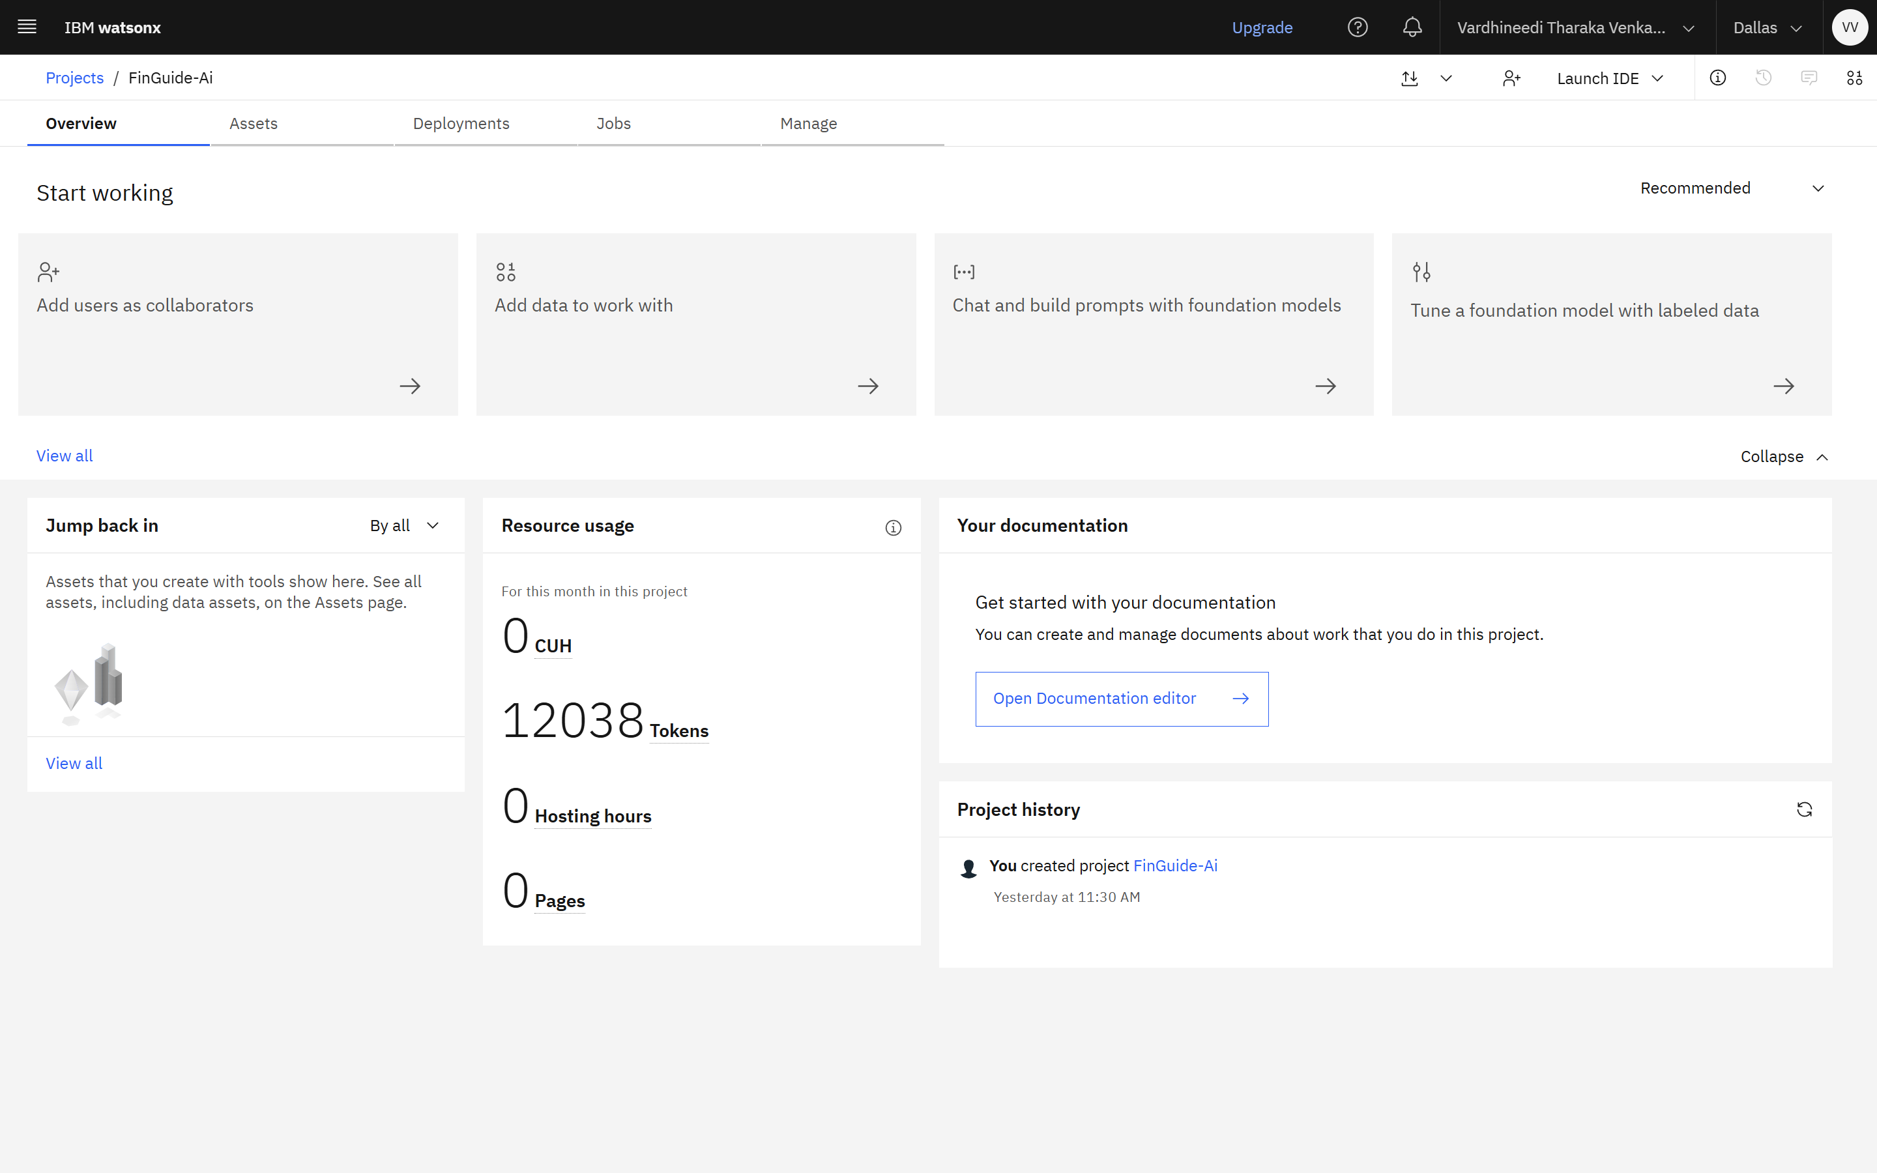

Token Usage
Before Prompt
After Prompt

Slide 11
Novelty and Uniqueness
The proposed FinGuide-AI stands out by combining Agentic AI, RAG, and multilingual support into a single intelligent financial literacy system.
Multi-Agent Intelligence: Instead of a single chatbot, specialized agents collaborate to deliver accurate, context-aware financial guidance.
RAG-Based Accuracy: Integrates real-time data retrieval from trusted Gov/Bank sources with AI generation, reducing misinformation and preventing fraud.
Hyper-Personalization & Multilingual Support: Tailors financial advice based on user queries and preferred language, ensuring cultural inclusivity.
Proactive Fraud Protection: Actively educates users on identifying and avoiding online financial scams.
Scalable & Secure: Built on IBM Cloud with IBM Granite models, ensuring reliability, security, and governance.
This makes the solution a smart, adaptive, and proactive digital financial advisor, not just a static FAQ tool.

Slide 12
Git Hub Link & Deployment
GitHub Repository: https://github.com/vardhineeditharak/FinGuide-Ai
Deployed Application: https://fin-guide-ai-six.vercel.app/
Repository Contents:
fin-literacy-agent/
├── app.py # Flask app + chat API endpoint
├── rag_pipeline.py # Retrieval + Granite generation logic
├── ingest.py # Builds the vector knowledge base from /data
├── data/ # Curated source documents (UPI, scams, loans, budgeting)
├── vectorstore/ # Chroma persistent DB & SQLite DB
├── templates/index.html # Chat UI
├── static/style.css # Chat UI styling
├── static/script.js # Chat UI logic
├── requirements.txt
└── .env.example

Slide 13
Future Scope
Integration with Banking APIs: The system can be integrated with secure banking APIs (like Account Aggregator) to provide highly personalized budgeting and expense tracking based on actual user transaction history.
AI-Powered Voice Assistant & Regional Dialect Support: Enhancing the system with voice-enabled interaction and support for deeper regional dialects will improve accessibility for rural populations and visually impaired users.
Real-Time Scam Alert Notifications: Implementing a proactive alert system that notifies users of newly emerging digital financial frauds in their specific region.

Slide 14
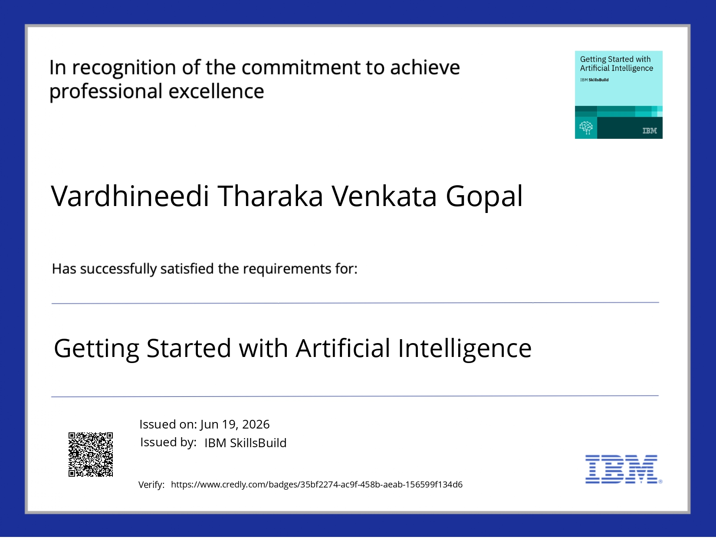
Certificates Earned

Slide 15

Certificates Earned
IBM Bob Certificate

Slide 16
Thank You!
Thank You for your Time and Interest

